Slide 1
Chapter 7:
Arrays and Vectors

Slide 2
7.1
Arrays Hold Multiple Values

Slide 3
Arrays Hold Multiple Values
Array: variable that can store multiple values of the same type
Values are stored in adjacent memory locations
Declared using [] operator:
  int tests[5];

Slide 4
Array - Memory Layout
The definition:
  int tests[5];
allocates the following memory:
first element | second element | third element | fourth element | fifth element

Slide 5
Array Terminology
In the definition int tests[5];
int is the data type of the array elements
tests is the name of the array
5, in [5], is the size declarator. It shows the number of elements in the array.
The size of an array is (number of elements) * (size of each element)

Slide 6
Array Terminology
The size of an array is:
  the total number of bytes allocated for it
  (number of elements) * (number of bytes for each element)
Examples:
  int tests[5] is an array of 20 bytes, assuming 4 bytes for an int
  long double measures[10]is an array of 80 bytes, assuming 8 bytes for a long double

Slide 7
Size Declarators
Named constants are commonly used as size declarators.
const int SIZE = 5;
int tests[SIZE];
This eases program maintenance when the size of the array needs to be changed.

Slide 8
7.2
Accessing Array Elements

Slide 9
Accessing Array Elements
Each element in an array is assigned a unique subscript.
Subscripts start at 0
subscripts:
0 | 1 | 2 | 3 | 4

Slide 10
Accessing Array Elements
The last element’s subscript is n-1 where n is the number of elements in the array.
subscripts:
0 | 1 | 2 | 3 | 4

Slide 11
Accessing Array Elements
Array elements can be used as regular variables:
  tests[0] = 79;
  cout << tests[0];
  cin >> tests[1];
  tests[4] = tests[0] + tests[1];
Arrays must be accessed via individual elements:
  cout << tests; // not legal

Slide 12
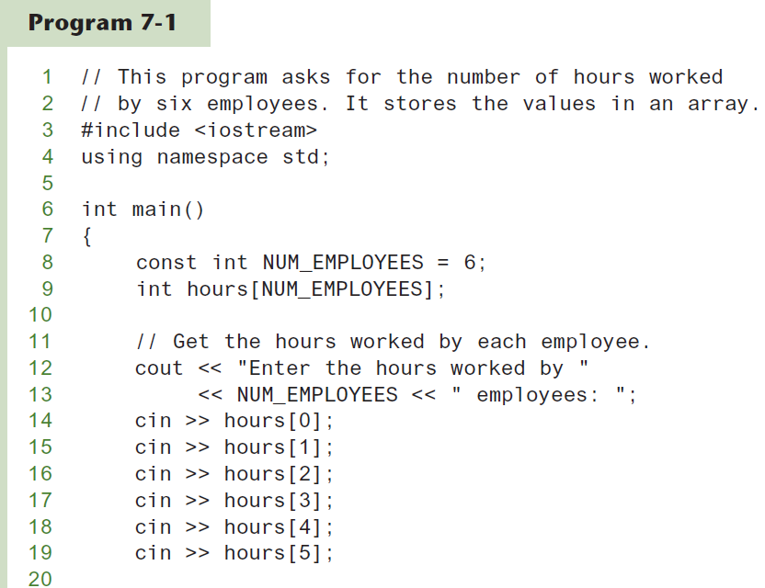
Accessing Array Elements in Program 7-1
(Program Continues)

Slide 13
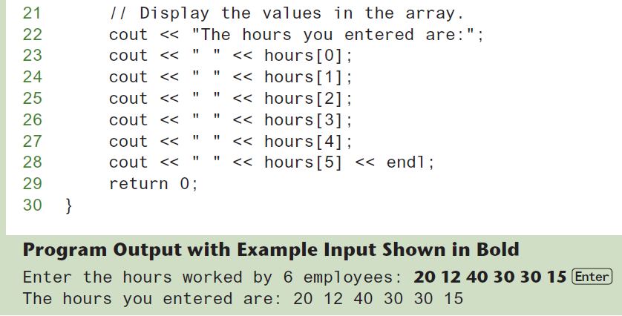
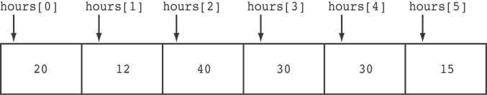
Accessing Array Elements in Program 7-1
Here are the contents of the hours array, with the values entered by the user in the example output:

Slide 14
Accessing Array Contents
Can access element with a constant or literal subscript:
  cout << tests[3] << endl;
Can use integer expression as subscript:
  int i = 5;
  cout << tests[i] << endl;

Slide 15
Using a Loop to Step Through an Array
Example – The following code defines an array, numbers, and assigns 99 to each element:
const int ARRAY_SIZE = 5;
int numbers[ARRAY_SIZE];
for (int count = 0; count < ARRAY_SIZE; count++)
numbers[count] = 99;

Slide 16
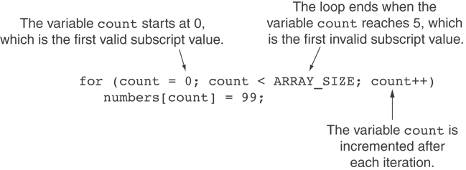
A Closer Look At the Loop

Slide 17
Default Initialization
Global array → all elements initialized to 0 by default
Local array → all elements uninitialized by default

Slide 18
Array Initialization
Arrays can be initialized with an initialization list:
const int SIZE = 5;
int tests[SIZE] = {79,82,91,77,84};
The values are stored in the array in the order in which they appear in the list.
The initialization list cannot exceed the array size.

Slide 19
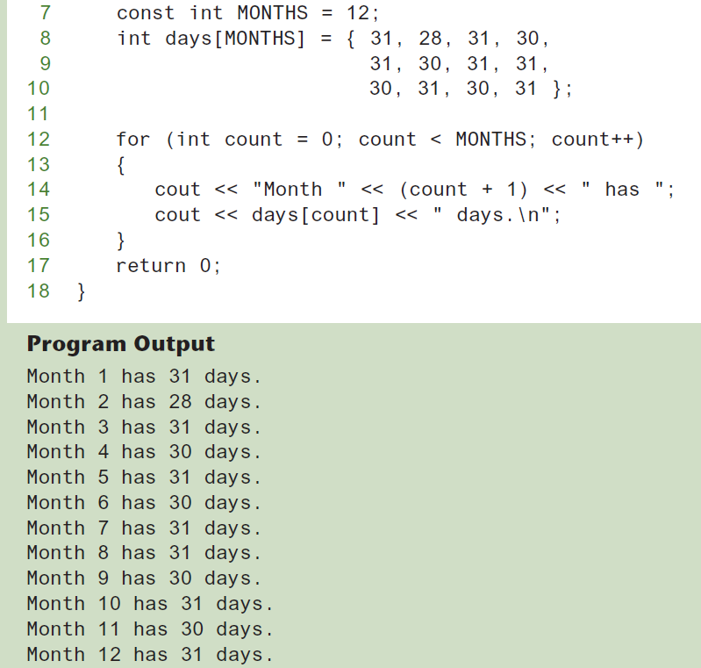
Code From Program 7-3

Slide 20
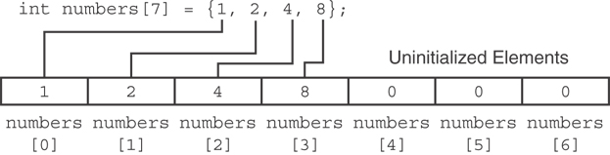
Partial Array Initialization
If array is initialized with fewer initial values than the size declarator, the remaining elements will be set to 0:

Slide 21
Implicit Array Sizing
Can determine array size by the size of the initialization list:
  int quizzes[]={12,17,15,11};
Must use either array size declarator or initialization list at array definition
12 | 17 | 15 | 11

Slide 22
7.3
No Bounds Checking in C++

Slide 23
No Bounds Checking in C++
When you use a value as an array subscript, C++ does not check it to make sure it is a valid subscript.
In other words, you can use subscripts that are beyond the bounds of the array.

Slide 24
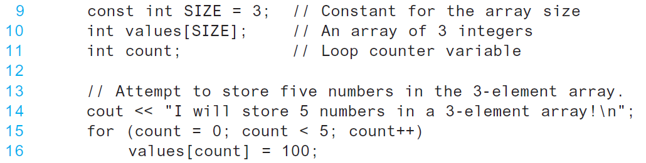
Code From Program 7-9
The following code defines a three-element array, and then writes five values to it!

Slide 25
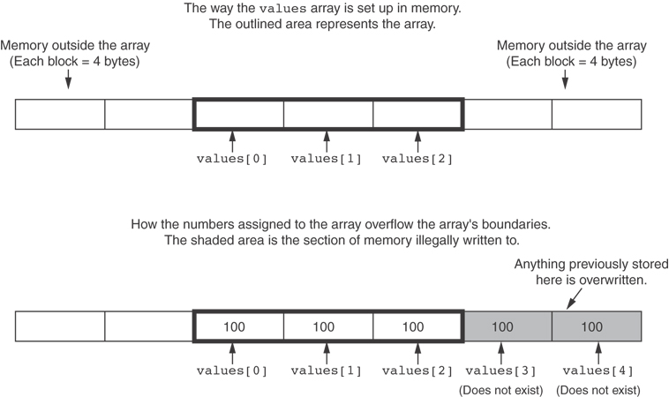
What the Code Does

Slide 26
No Bounds Checking in C++
Be careful not to use invalid subscripts.
Doing so can corrupt other memory locations, crash program, or lock up computer, and cause elusive bugs.

Slide 27
Off-By-One Errors
An off-by-one error happens when you use array subscripts that are off by one.
This can happen when you start subscripts at 1 rather than 0:
// This code has an off-by-one error.
const int SIZE = 100;
int numbers[SIZE];
for (int count = 1; count <= SIZE; count++)
numbers[count] = 0;

Slide 28
7.4
The Range-Based for Loop

Slide 29
The Range-Based for Loop
C++ 11 provides a specialized version of the for loop that, in many circumstances, simplifies array processing.
The range-based for loop is a loop that iterates once for each element in an array.
Each time the loop iterates, it copies an element from the array to a built-in variable, known as the range variable.
The range-based for loop automatically knows the number of elements in an array.
  You do not have to use a counter variable.
  You do not have to worry about stepping outside the bounds of the array.

Slide 30
The Range-Based for Loop
Here is the general format of the range-based for loop:
dataType is the data type of the range variable.
rangeVariable is the name of the range variable. This variable will receive the value of a different array element during each loop iteration.
array is the name of an array on which you wish the loop to operate.
statement is a statement that executes during a loop iteration. If you need to execute more than one statement in the loop, enclose the statements in a set of braces.
for (dataType rangeVariable : array)
statement;

Slide 31
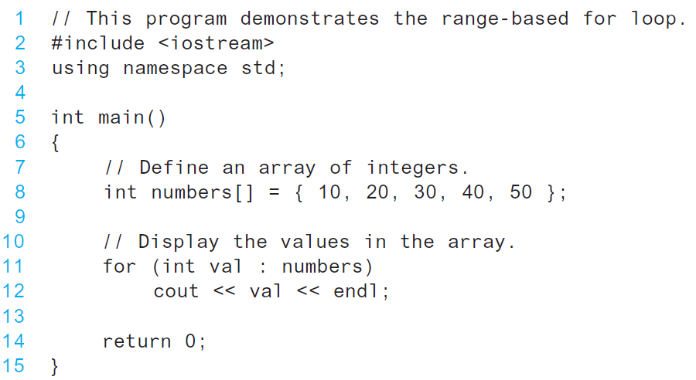
The range-based for loop in Program 7-10

Slide 32
Modifying an Array with a Range-Based for Loop
As the range-based for loop executes, its range variable contains only a copy of an array element.
You cannot use a range-based for loop to modify the contents of an array unless you declare the range variable as a reference.
To declare the range variable as a reference variable, simply write an ampersand (&) in front of its name in the loop header.
Program 7-12 demonstrates

Slide 33
Modifying an Array with a Range-Based for Loop in Program 7-12
const int SIZE = 5;
int numbers[5];
// Get values for the array.
for (int &val : numbers)
{
cout << "Enter an integer value: ";
cin >> val;
}
// Display the values in the array.
cout << "Here are the values you entered:\n";
for (int val : numbers)
cout << val << endl;

Slide 34
Modifying an Array with a Range-Based for Loop
You can use the auto key word with a reference range variable. For example, the code in lines 12 through 16 in Program 7-12 could have been written like this:
for (auto &val : numbers)
{
cout << "Enter an integer value: ";
cin >> val;
}

Slide 35
The Range-Based for Loop versus the Regular for Loop
The range-based for loop can be used in any situation where you need to step through the elements of an array, and you do not need to use the element subscripts.
If you need the element subscript for some purpose, use the regular for loop.

Slide 36
7.5
Processing Array Contents

Slide 37
Processing Array Contents
Array elements can be treated as ordinary variables of the same type as the array
When using ++, -- operators, don’t confuse the element with the subscript:
  tests[i]++; // add 1 to tests[i]
  tests[i++]; // increment i, no
  // effect on tests

Slide 38
Array Assignment
To copy one array to another,
Don’t try to assign one array to the other:
  newTests = tests; // Won't work
Instead, assign element-by-element:
  for (i = 0; i < ARRAY_SIZE; i++)
  newTests[i] = tests[i];

Slide 39
Printing the Contents of an Array
You can display the contents of a character array by sending its name to cout:
char fName[] = "Henry";
  cout << fName << endl;
  But, this ONLY works with character arrays!

Slide 40
Printing the Contents of an Array
For other types of arrays, you must print element-by-element:
  for (i = 0; i < ARRAY_SIZE; i++)
  cout << tests[i] << endl;

Slide 41
Printing the Contents of an Array
In C++ 11 you can use the range-based for loop to display an array's contents, as shown here:
for (int val : numbers)
cout << val << endl;

Slide 42
Summing and Averaging Array Elements
Use a simple loop to add together array elements:
  int tnum;
  double average, sum = 0;
  for(tnum = 0; tnum < SIZE; tnum++)
  sum += tests[tnum];
Once summed, can compute average:
  average = sum / SIZE;

Slide 43
Summing and Averaging Array Elements
In C++ 11 you can use the range-based for loop, as shown here:
double total = 0; // Initialize accumulator
double average; // Will hold the average
for (int val : scores)
total += val;
average = total / NUM_SCORES;

Slide 44
Finding the Highest Value in an Array
int count;
int highest;
highest = numbers[0];
for (count = 1; count < SIZE; count++)
{
if (numbers[count] > highest)
highest = numbers[count];
}
When this code is finished, the highest variable will contains the highest value in the numbers array.

Slide 45
Finding the Lowest Value in an Array
int count;
int lowest;
lowest = numbers[0];
for (count = 1; count < SIZE; count++)
{
if (numbers[count] < lowest)
lowest = numbers[count];
}
When this code is finished, the lowest variable will contains the lowest value in the numbers array.

Slide 46
Partially-Filled Arrays
If it is unknown how much data an array will be holding:
  Make the array large enough to hold the largest expected number of elements.
  Use a counter variable to keep track of the number of items stored in the array.

Slide 47
Comparing Arrays
To compare two arrays, you must compare element-by-element:
const int SIZE = 5;
int firstArray[SIZE] = { 5, 10, 15, 20, 25 };
int secondArray[SIZE] = { 5, 10, 15, 20, 25 };
bool arraysEqual = true; // Flag variable
int count = 0; // Loop counter variable
// Compare the two arrays.
while (arraysEqual && count < SIZE)
{
if (firstArray[count] != secondArray[count])
arraysEqual = false;
count++;
}
if (arraysEqual)
cout << "The arrays are equal.\n";
else
cout << "The arrays are not equal.\n";

Slide 48
Structured Binding Declarations
A structured binding declaration defines a set of variables and initializes them with the values that are stored in an array.
Structured binding declarations were introduced in C++ 17
General format:
auto [variable1, variable2, etc...] = array;

Slide 49
Structured Binding Declarations
Example:
int testScores[] = { 80, 90, 100 };
auto [score1, score2, score3] = testScores;
cout << score1 << endl;
cout << score2 << endl;
cout << score3 << endl;
This code will display:
80
90
100

Slide 50
7.6
Using Parallel Arrays

Slide 51
Using Parallel Arrays
Parallel arrays: two or more arrays that contain related data
A subscript is used to relate arrays: elements at same subscript are related
Arrays may be of different types

Slide 52
Parallel Array Example
const int SIZE = 5; // Array size
int id[SIZE]; // student ID
double average[SIZE]; // course average
char grade[SIZE]; // course grade
...
for(int i = 0; i < SIZE; i++)
{
cout << "Student ID: " << id[i]
<< " average: " << average[i]
<< " grade: " << grade[i]
<< endl;
}

Slide 53
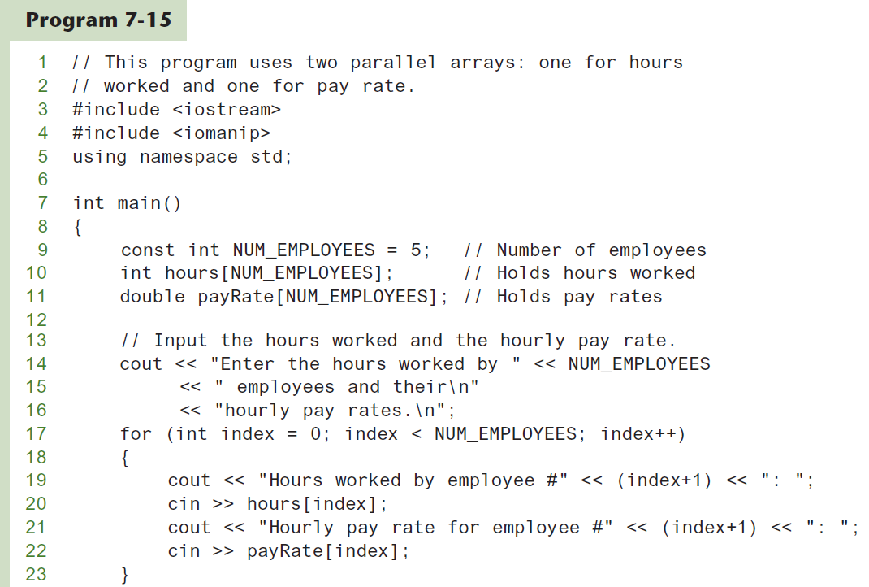
Parallel Arrays in Program 7-15
(Program Continues)

Slide 54
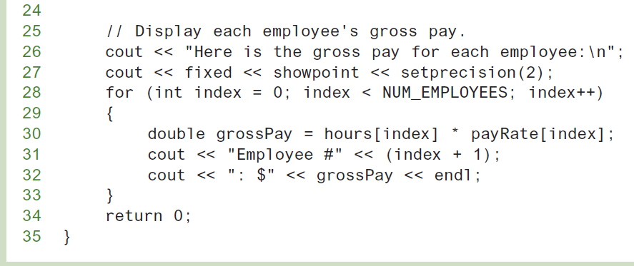
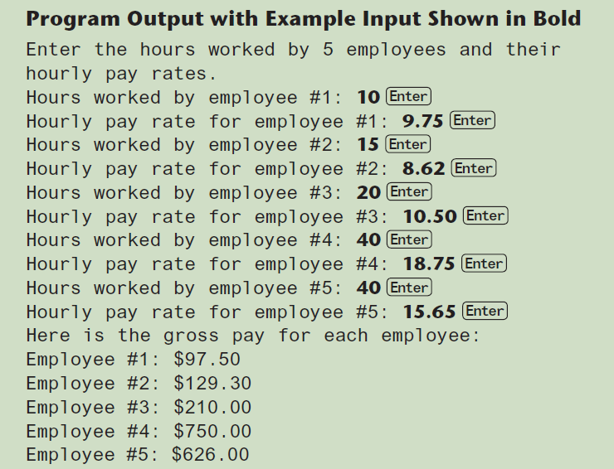
Parallel Arrays in Program 7-15

Slide 55
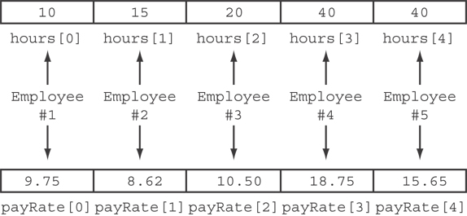
Parallel Arrays in Program 7-15
The hours and payRate arrays are related through their subscripts:

